Slide 1
Medicare: What Will Be
Its Future?
Health Watch USA
May 15, 2013
Rosemary Gibson
Section Editor, Less is More
JAMA Internal Medicine
Author, Medicare Meltdown, The Battle Over Health Care, The Treatment Trap, Wall of Silence

Slide 2
Medicare is a Timely Topic
Last week the federal government released Medicare data on hospital charges for common procedures and how much Medicare paid
“Even on the same street, hospitals can vary by upwards of 300 percent in price for the same service…”
Source: Washington Post, May 8, 2013 http://www.washingtonpost.com/wp-srv/special/national/how-much-hospitals-charge/

Slide 3
Kentucky Hospital Charges for a Cardiac Stent: DRG 246
Hospital Hospital Medicare
Charges Payment
Pikeville Med Ctr: $101,594 $36,313
Baptist Hosp.East $ 43,823 $16,741
Lake
Cumberland $100,291 $20,747
https://data.cms.gov/Medicare/Inpatient-Prospective-Payment-System-IPPS-Provider/97k6-zzx3

Slide 4
Main Points of this Presentation
Seniors’ entitlement to Medicare is not what is causing Medicare’s long-term fiscal challenges
The health care industry’s sense of entitlement to Medicare’s money is what is driving Medicare over the fiscal cliff
Seniors should not be asked to pay more (e.g. eligibility age increase) until the industry reduces cost and improves quality

Slide 5
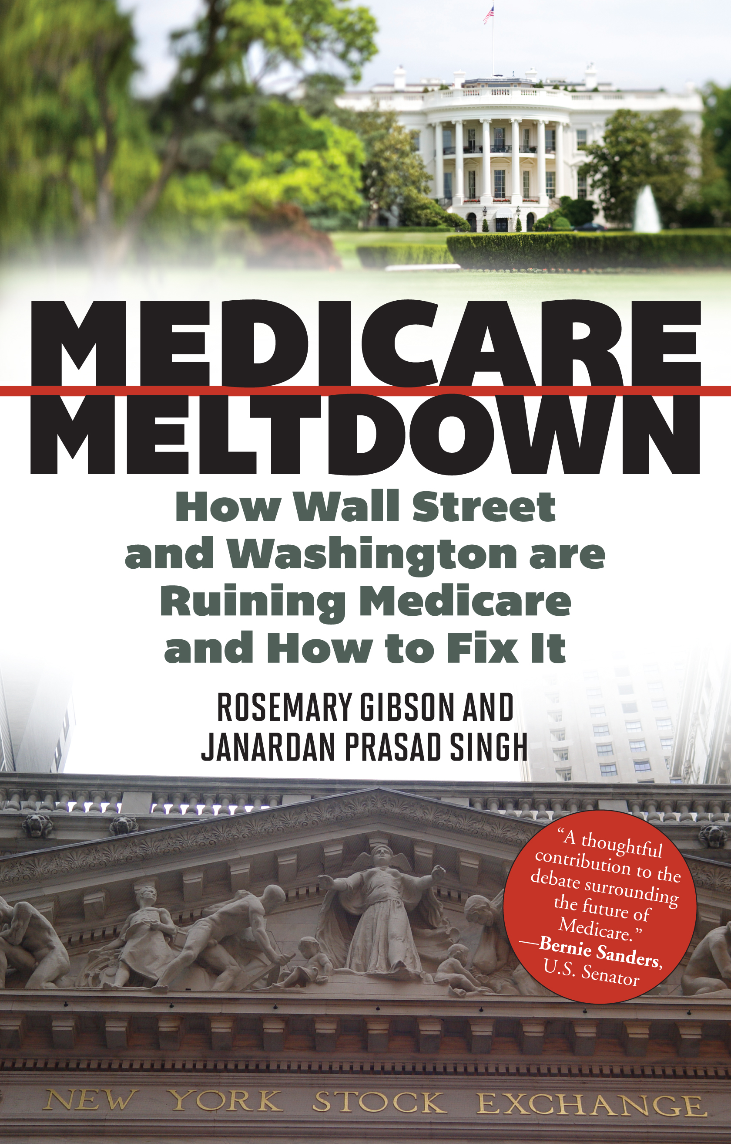

Slide 6
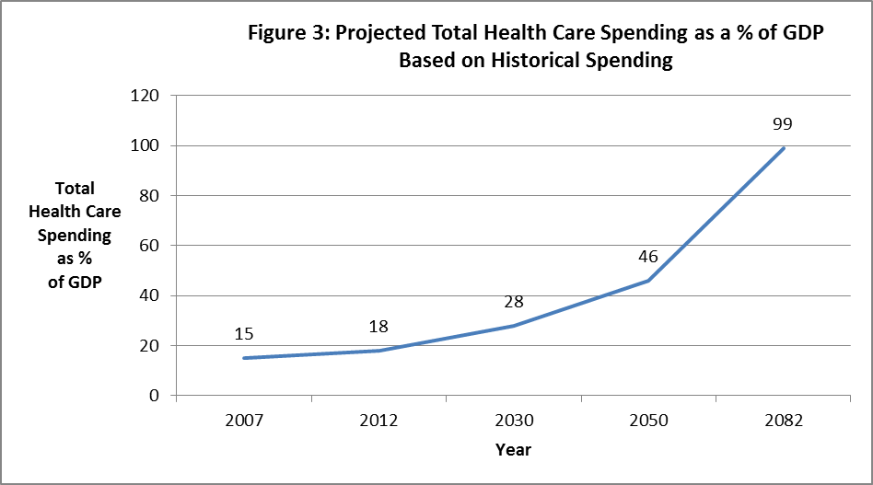
Source: Congressional Budget Office, Long-Term Budget Outlook, 2007, Appendix D

Slide 8
“They’re coming for your Social Security….”
George Carlin

Slide 9
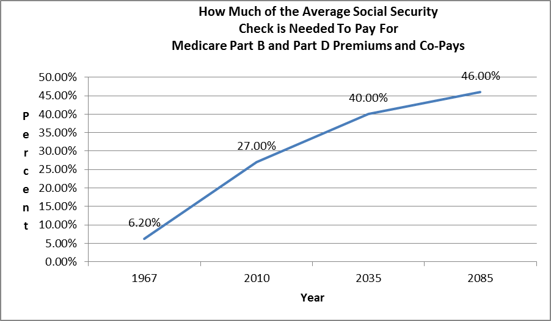

Slide 10
Medicare Meltdown
Where is the money going?
Who is getting it?
What are they doing with it?
What can we do about it?

Slide 11
Medicare is Big Business
In 1965, there were no health care companies on the Fortune 100 list
Today, 15 health care companies are on that list and depend on Medicare for their revenue

Slide 12
Who Pays for Medicare?
You Do
All of us who work pay for Medicare from a 2.9% payroll tax deducted from every paycheck. Look at your pay stub and you will see the deduction
You also pay for Medicare from your federal income tax from your paychecks
Seniors over age 65 pay premiums and co-payments

Slide 13
Medicare Waste
The Institute of Medicine of the National Academy of Sciences estimates that 30% of Medicare spending is wasted on administrative inefficiencies, unnecessary treatment, and fraud and abuse
This amount of Medicare waste ($170 billion) is the size of the entire economy of New Zealand

Slide 14
A Conscientious Doctor Who
Tried to Cut Waste
A pediatric neurosurgeon wanted to know the price of the supplies in his operating room
He found $700,000 worth of supplies
10% had expired and had to be thrown away ($70,000)
He only needed $295,000 of the $700,000 supplies.

Slide 15
The Brick Ceiling
Savings for his health care system?
Hitting the brick ceiling: the non-competitive, non-transparent “market” for hospital supplies and equipment,
This $200 billion market was given anti-kickback exemption from Congress in 1980s
What was supposed to be a Costco model has turned into the most expensive way of purchasing supplies and equipment

Slide 16
The Age of Productivity is
Driving Up Cost
Researchers at the Mayo Clinic surveyed more than 7,000 doctors and 46 percent had at least one symptom of burnout
Demands for more “productivity” are one factor in doctor burnout and unhappiness.

Slide 17


Slide 18
Productivity Demands on Physicians
60 Minutes reported on a for-profit hospital system that allegedly pressured its ER doctors to admit more and more patients -- regardless of medical need -- in order to increase revenues
ER Director to ER doctors: “I’ve been told to replace you if don’t meet your numbers.”
http://www.cbsnews.com/video/watch/?id=50136261n

Slide 19
Productivity Demands
When physicians thought it appropriate to send a patient home from the ER, the hospital computer system would send a message questioning the physician’s decision
Physicians were concerned about non-physicians telling physicians whether or not to admit a patient from the ER
http://www.cbsnews.com/video/watch/?id=50136261n

Slide 20


Slide 21


Slide 22
Patients may think that they are receiving good care, that the doctors are being thorough
They are unlikely to be aware that they are being placed at risk by being admitted to the hospital ,e.g. the risk of infection, complications from diagnostic tests, without any benefit
Patients pay the Medicare annual deductible for hospital care, which this year is more than $1100 + a 20% co-payment for the cost of each day

Slide 23
Medicare Fraud
The hospital is under investigation
The FBI estimates that up to 10 percent of the money Medicare spends each year, or nearly $60 billion a year, is lost to fraud
This amount is equivalent to the lifetime contributions to Medicare from about 1 million middle income seniors every year

Slide 24
As the Business of Medicare Grows, So Does the Risk of Dual Loyalty
Facilities with questionable cultures that put finances ahead of patients create challenges for the ethical physician
For-profit facilities have a primary legal duty to shareholders, not patients
A physician’s license requires that s/he has a primary duty to patients

Slide 25
Example of Overuse in Medicare
Overuse of complex back surgeries on people on Medicare
He examined Medicare billing data from 2002 to 2007 for various forms of surgery for spinal stenosis
http://jama.ama-assn.org/cgi/content/full/303/13/1259?home

Slide 26
While the overall rate of surgery for spinal stenosis did not increase, more people had a more complex type of surgery
The use of more complex surgical approaches was correlated with a higher rate of complications, a greater risk of death, and more than three times greater hospital charges.

Slide 27


Slide 28
Medicare Incentives Drive
Higher Cost Procedures
The result: a surgery that has no proof of added benefit went from a rarely performed procedure to comprise one-fifth of all surgeries of that type, increasing the risk to patients and increasing Medicare spending

Slide 29
Reasons for
Higher Cost Procedures
According to the authors, medical device makers have heavily promoted the devices and materials used in more complex surgeries which can cost as much as $50,000 per operation
A JAMA editorial noted that the surgical fees can be 10 times more for the more complex surgery with more complications
http://jama.ama-assn.org/cgi/content/full/303/13/1309?home

Slide 30
A Conclusion to Draw
Seniors’ entitlement to Medicare is not why Medicare is headed over a fiscal cliff
The health care industry’s entitlement to Medicare’s money is driving Medicare over the cliff

Slide 31
The Transformation of the
Medicare Hospice Benefit
Hospice care accounts for 1 percent of Medicare spending and its trends are a microcosm of Medicare overall
Hospice care in the US began as a charitable
In the 1980s, Medicare began to pay for hospice care

Slide 32
Hospices are paid on a per diem basis, around $150 a day
Just 25 years later, half of all hospices are for-profit
Many of the largest for profit hospices have settled with the US Department of Justice for enrolling people who are not dying, which is fraudulent use of Medicare

Slide 33
From Patient-Centered to Business
The largest for-profit hospice in the US, Vitas, has under federal investigation for Medicare fraud. A former manager accused the hospice chain of enrolling people who were not terminally ill. The parent company is Roto-Rooter plumbing
Hospices spend money to defend against these claims. That money comes from hospice revenue that, in turn, comes from the payroll tax contributions you make

Slide 34
From Patient-Centered to Business
In January 2012, the US DOJ joined a suit against an Arkansas-based hospice operating in 19 states
According to a Kaiser Health News report, hospice employees went door-to-door in public housing projects to find people they could label terminally ill and enroll them
Employees rode with Meals on Wheels volunteers to find prospective customers

Slide 35
Nurses were instructed to “chart negative” in the medical record even when patients were stable or improving to justify continuing the $150 per diem
Patients forgo curative care when in hospice
Non-clinical senior managers were involved in many decisions on when patients should leave hospice

Slide 36
Private Equity Firms in Hospice
Private equity firms are investing in for-profit hospices.
Private equity is used to bring working capital to a company to help it expand or restructure operations.
What value added does it bring to a labor-intensive activity that does not require any specialized management?

Slide 37
A market-based economy works when all parties to a transaction benefit
What are patients -- and all of us who pay for Medicare -- receiving in return for money being taken?
The public is compelled to ask: what is the benefit to the patient?

Slide 38
Speaking Truth
About Overuse
“I was brought into a 6000 employee hospital to assess the culture. The cardiac surgeons will do surgery on anyone who moves…
After meeting with the CEO I was told that I ‘upset him greatly with my comments that they were doing unethical and immoral surgeries.”

Slide 39
Speaking Truth
About Overuse
…When I met with the CEO again, he was visibly shaken with his head in his hands and ‘feeling ill.’
…So much of what goes on travels just under the level of awareness…
… It was painful to witness.”

Slide 40
“All truth passes through three stages. First it is ridiculed. Second, it is violently opposed. Third, it is accepted as being self-evident.”
Arthur Schopenhauer
19th century philosopher

Slide 41
Price x Volume = Total Spending

Slide 42
When 1 Night in the Hospital
Costs as Much as a House
A 65-year old Medicare beneficiary : for 1 night in the hospital: $244,041
He wrote a letter to the editor in his local newspaper – and the hospital requested the paper not publish such information
More public discourse, not less, is needed to change the status quo

Slide 43
John Bogle, founder of Vanguard Mutual Funds, describes the “pathological mutation” that has gripped Wall Street in his book, The Battle for the Soul of Capitalism
If money cannot be made honestly, then “cheat”
We have a battle waging for the soul of health care. A pathological mutation is gripping it, to the dismay of ethical physicians

Slide 45
Fallout from the Pressures
Older adults on Medicare are harmed by preventable adverse events
The U.S. Department of Health and Human Services reviewed a random sample of medical records of older adults
Estimate: 79,200 Medicare beneficiaries a year die b/c of preventable harm in hospitals

Slide 46


Slide 47
Limits to health care spending
Is it time?
No system can function without limits
A country can’t work without red lights

Slide 48
There are no limits on the total amount of how much hospitals and other providers bill Medicare
There is no market mechanism or regulatory structure to place limits
This was a chief design flaw of Medicare when it was enacted in 1965. It is called the open-ended entitlement

Slide 49

Install Red Lights

Slide 50
Install Red Lights
Maryland officials have proposed an ambitious effort to limit hospital spending so it grows no faster than the overall economy.
It would use Maryland's unique rate-setting system to keep hospital spending from growing at roughly half its recent rate of increase.
http://www.kaiserhealthnews.org/stories/2013/april/01/maryland-hospital-cost-control-changes.aspx

Slide 51
Install Red Lights
Massachusetts: capped total health care spending – private and public – so it would not grow faster than the economy.

Slide 52
Proposed Limits to
Medicare Spending
In 2012 both President Obama and Paul Ryan proposed limiting average Medicare spending per beneficiary to GDP growth plus 0.5 percent.
http://crfb.org/blogs/it-turns-out-ryan-and-obama-agree-putting-Medicare-budget

Slide 53
In Closing…
A patient is the most important person on our premises. He is not dependent on us. We are dependent on him. He is not an interruption in our work. He is the purpose of it. He is not an outsider in our business. He is part of it. We are not doing him a favor by serving him. He is doing us a favor by giving us the opportunity to serve him…. Gandhi

Slide 54
Contact:
Rosemarygibson100@gmail.com

